Slide 1
Pathogenic protozoan and Malaria & Phytophthora Dieback

Slide 2
Pathogen - Protist

Slide 3
Kingdom Protista
Protists are a diverse and mostly unicellular group of eukaryotic organisms.
Of the 65 000 known species of protists, less than 24 species cause diseases in humans, but these few infect hundreds of millions of people each year.
To date, we still do not have effective preventatives against many of
them, and the treatment drugs we have are limited in their effectiveness.
Some protists resemble animal cells, some resemble plant cells and some resemble fungi cells.
A variety of specific, unique features set them apart.

Slide 4
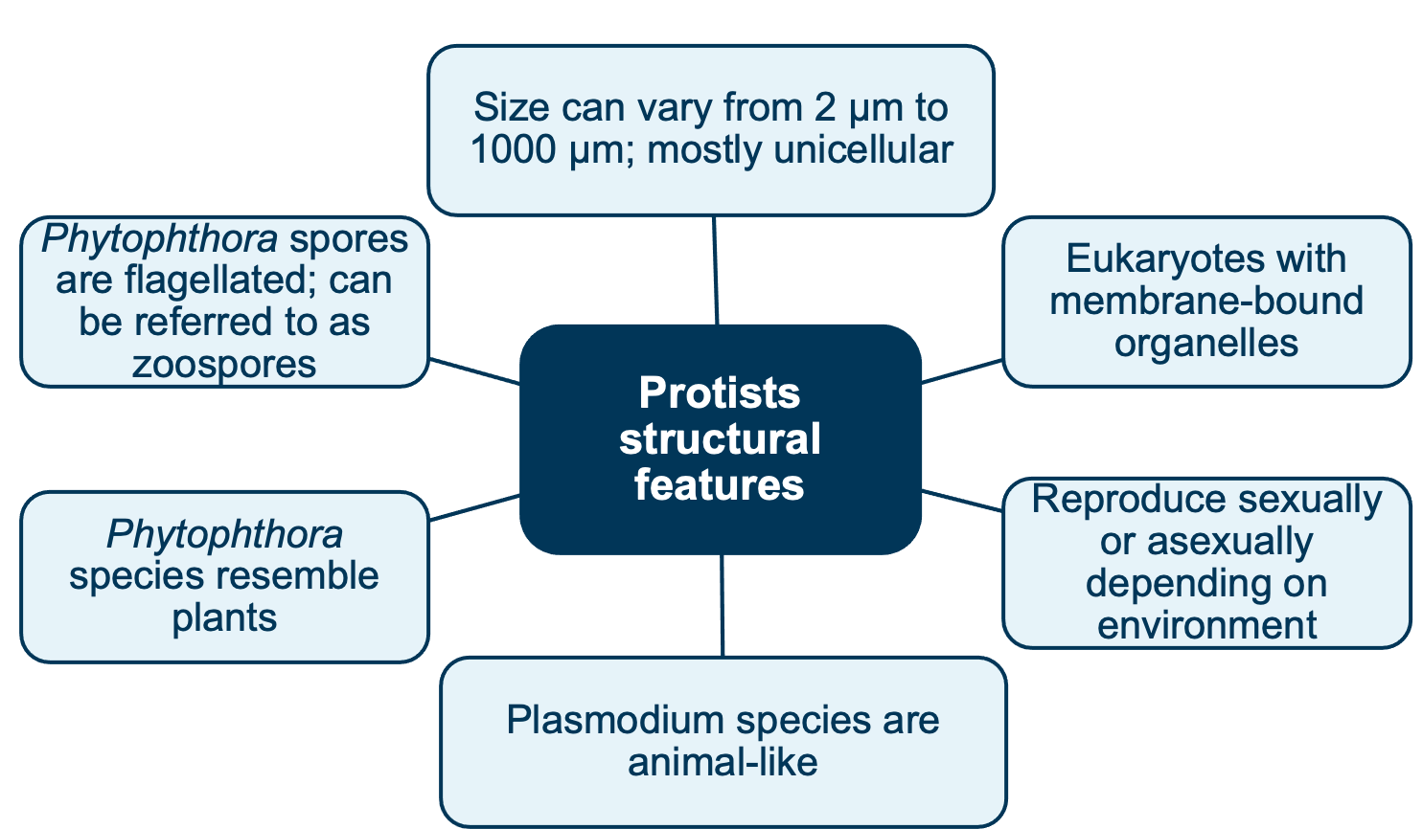
Protists structural features
Some have cell wall or protective outer layer
Have nucleus. May have multiple nuclei

Slide 5
Compare all 4 pathogens
Viruses | Bacteria | Fungi | Protista
Protein Coat – Capsid surrounds nucleic acid DNA or RNA No Cell Wall enveloped viruses have a phospholipid bilayer Have no ribosomes or membrane bound organelle as they are metabolically inert | DNA not in nucleus in cytoplasm DNA Cell Wall composed peptidoglycan Only have ribosomes have no membrane bound organelles – they are prokaryotic | DNA in nucleus DNA Cell Wall composed of Chitin Have ribosomes & membrane bound organelles – they are eukaryotes | DNA in nucleus DNA Some have a Cell Wall composed of cellulose some do not Have ribosomes & membrane bound organelles – they are eukaryotes

Slide 6
Protist disease examples:
Five species of Plasmodium cause malaria. The symptoms are fever, headache, chills (shaking), sweating and vomiting. If left untreated and a host is susceptible, complications such as anaemia and liver failure can develop, and may lead to death.
Giardia lamblia is a relatively common parasite that infects travellers. This flagellated protist can cause mild intestinal upsets, such as diarrhoea, but may also have more severe effects in the young or the elderly. People become infected if they drink contaminated water. It is a major problem in
Scientific Reports, Springer Nature Ltd. CC-BY 4.0
Licence http://creativecommons.org/licenses/by/4.0/
many developing countries, where travellers are advised never to drink water that is not bottled or boiled.

Slide 7
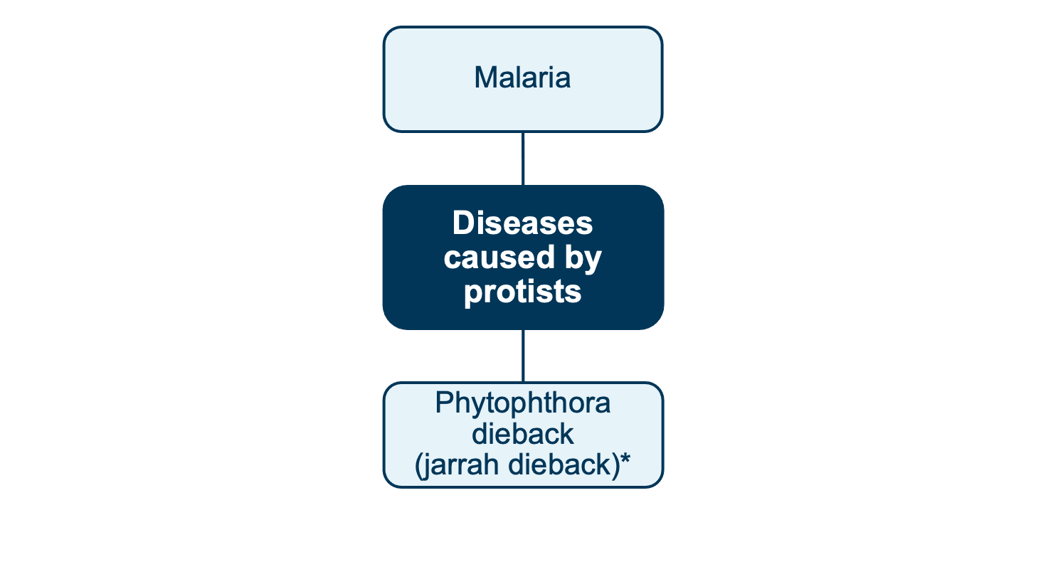
Examples of diseases caused by protists
*The Phylum Oomycota containing Phytophthora dieback has been removed
from the Fungi Kingdom and placed in the Protista Kingdom

Slide 8
Biology WA Units 3 & 4
Set 12.3b pg.422 Q 1-7

Slide 9
Life cycle –Plasmodium

Slide 10
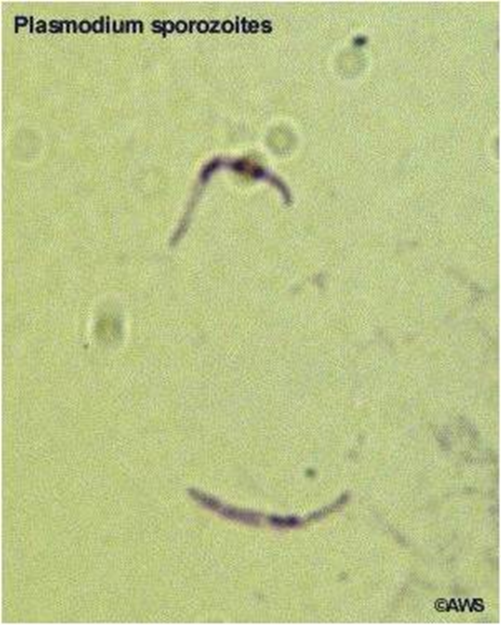
Malaria
The disease malaria is caused by unicellular protists from the Plasmodium genus.
Plasmodium species belong to a Protistan group resembling animal cells. The animal-type protists can be referred to as protozoa.
There are more than 100 kinds of Plasmodium that can infect many animal species such as reptiles, birds and mammals.
There are six different species of malaria parasite that cause malaria in humans. Below are the four most common in humans:
  Plasmodium falciparum,
  Plasmodium vivax,
  Plasmodium ovale (two subspecies)
  Plasmodium malariae
  and the very rare Plasmodium knowlesi.

Slide 11
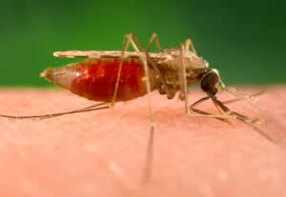
Malaria
Plasmodium falciparum (Africa) and Plasmodium vivax (Asia) are the most common types of malaria parasite that infect humans.
Plasmodium falciparum causes the most serious, life-threatening infections in humans as it affects all ages of red blood cells
(see Biozone Act 82).
The Anopheles minimus mosquito, a malaria vector that carries the drug-resistant malaria parasite P. falciparum, feeding on a human host. The blood that this mosquito ingested is visible through its abdomen.
Courtesy of CDC

Slide 12
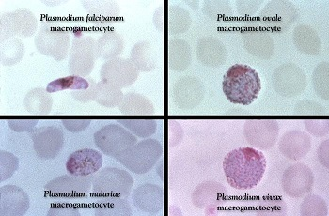
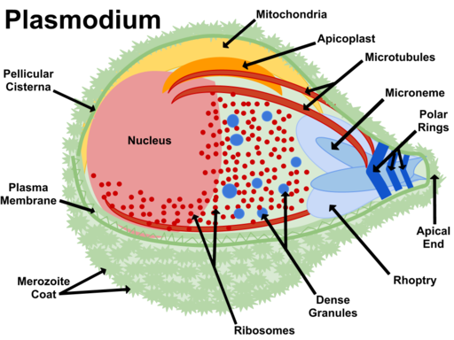
Structural Characteristics

Slide 13
Structural Characteristics
Species in the genus Plasmodium belong to a group of protists that resemble an animal cell
This group of animal-like protists are called protozoans
They have no chlorophyll or cell wall
They have no means of locomotion – no flagella
They have a membrane bound organelles
DNA is bound within a membrane bound nucleus
Have a plasma membrane (cell membrane)
Unicellular
Belong to a parasitic group called Sporozoa
These parasitic protists spread through their host in the form of tiny infectious cells called sporozites

Slide 14
Ecology of the Protozoan
Belong to a parasitic group called Sporozoa
These parasitic protists spread through their host in the form of tiny infectious cells called sporozites
Reproduce asexually and sexually

Slide 15
Ecology of the Protozoan
The Plasmodium are transmitted indirectly to a host by the bite of a pregnant female Anopheles mosquito vector.
These mosquitos most commonly bite between dusk & dawn
The parasite requires both the mosquito and the human host. Sexual reproduction occurs in the female mosquito gut, which is why the mosquito is known as the definitive host.
Asexual reproduction takes place in the liver and red blood cells of the human host, who is known as the intermediate host.
Malaria kills one child every 2 minutes globally. WHO has a target
to eliminate malaria by 2030.

Slide 16
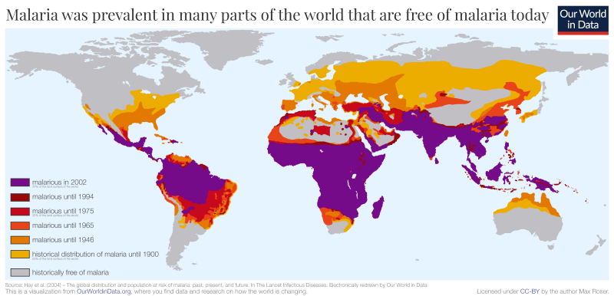

Slide 17
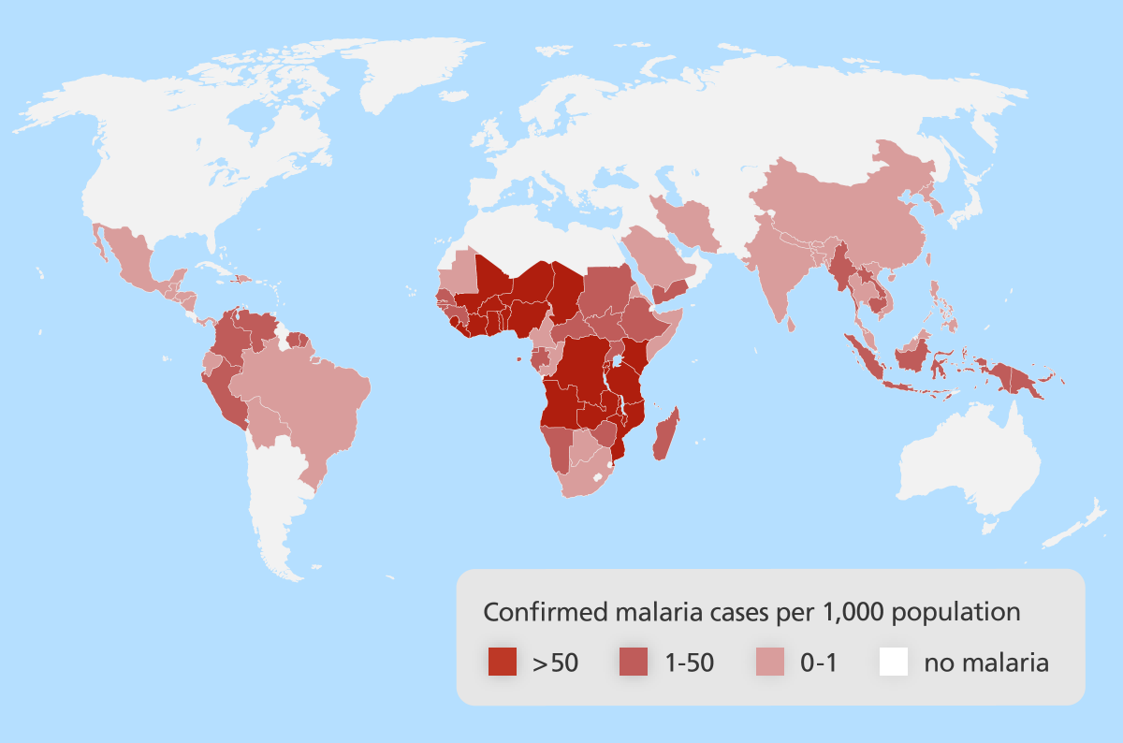
Distribution of Malaria - Current

Slide 18
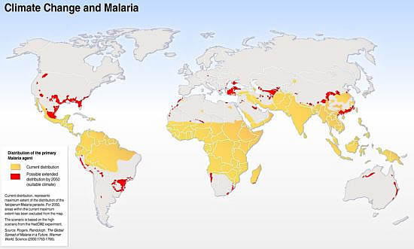
Distribution of Malaria – Future with Climate Change

Slide 19
Distribution of Malaria
Malaria is predominantly found in the tropical and sub-tropical areas of Africa, South America and Asia.
This is because the Anopheles mosquito thrives in warm, humid environments with high rainfall
Plasmodium falciparum requires warm temperatures (above 20C) to complete growth cycle within the mosquito
      Only P. vivax can complete its life cycle in lower temperatures
With Global climate change the risk of malaria infection is predicted to increased in regions of higher altitude and in tropical region – Why?
      Read https://scied.ucar.edu/learning-zone/climate-change-impacts/vector-borne-disease
About 3.3 billion people – half the worlds population – are at risk of malaria.

Slide 20
Mode of Transmission
Vector
When a pregnant female Anopheles mosquito bites a person already infected with malaria, their blood contains the protist, the mosquito can suck up the protist in the blood
The protist then reporoduces in the mosquito
The protist is tranmistted when the mosquito bites another uninfected person
Protist transmitted in the mosquito saliva
There are about 20 different Anopheles species around the world that are responsible for the spread of malaria between humans.

Slide 21
Mode of Transmission
Malaria is generally not spread directly from person to person. However, in some rare cases malaria has been spread through blood transfusions and the sharing of needles.
Malaria is most severe in villages that are surrounded by forests where rainfall patterns and humidity levels suit the mosquito best. The longer the life span of the mosquito, the longer the malaria parasite has to complete its development inside the mosquito.
Malaria transmission occurs mostly during the rainy season but rates of transmission can vary from one year to the next.

Slide 22
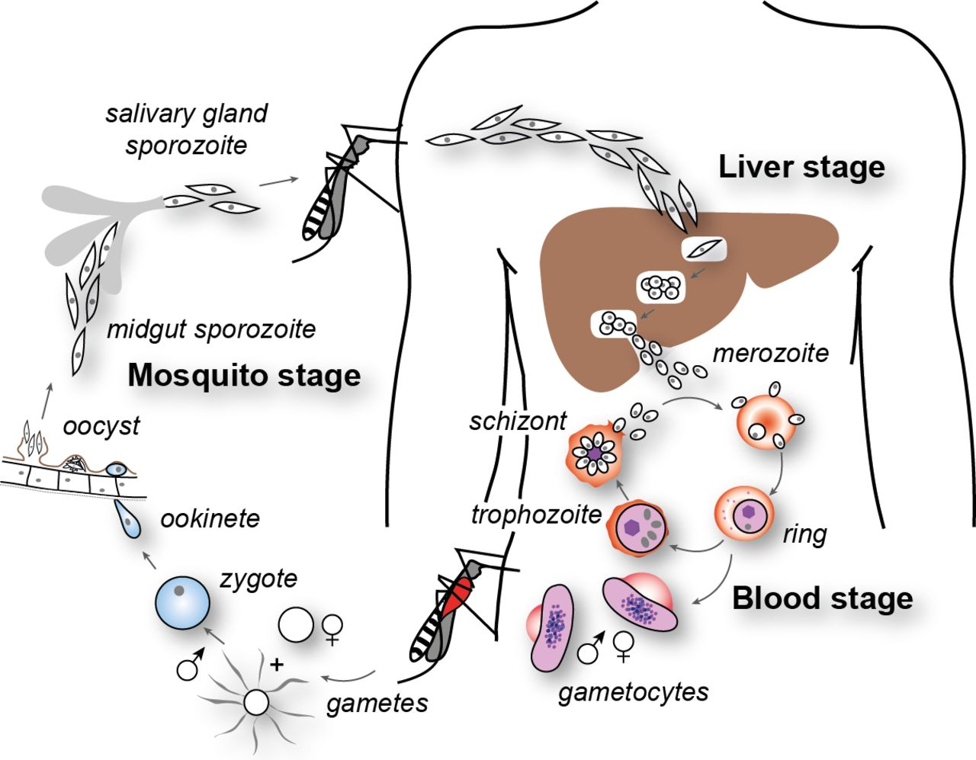
Plasmodium life cycle

Slide 23
Plasmodium life cycle
The Plasmodium life cycle starts when a mosquito carrying the malaria parasite bites a human, injecting the parasite (in its sporozoite form) in its saliva into the human bloodstream.

Slide 24
Plasmodium life cycle
Once injected into the blood, the sporozoites head straight to the liver and within 30 minutes they have invaded the liver cells.
Here they develop from sporozoites into merozoites and multiply rapidly to produce thousands of merozoites.
They are usually in the liver cells for 10 days.

Slide 25
Plasmodium life cycle
In some malaria species, such as Plasmodium vivax and Plasmodium ovale, the malaria parasites can lie dormant for months or years in the liver. This dormant form, the hypnozoite, can then become reactivated and continue its life cycle causing disease.
This dormant stage does not happen in Plasmodium falciparum.

Slide 26
Plasmodium life cycle
The merozoites burst out of the liver and invade red blood cells in the bloodstream. Here, they multiply further.
After 48 hours, the merozoites have multiplied so much that the red blood cells burst, releasing more merozoites into the bloodstream, which can then infect more red blood cells.

Slide 27
Plasmodium life cycle
Over 10 days some merozoites will develop into gametocytes. This is the sexual form of the parasite.
When another mosquito sucks up blood from an infected human they take up the gametocytes.

Slide 28
Plasmodium life cycle
Once inside the mosquito gut, the gametocytes mature into gametes.
Male and female gametes fuse together during sexual reproduction resulting in the formation of a mobile ookinete.

Slide 29
Plasmodium life cycle
The ookinete burrows through the mosquito’s stomach wall.
The ookinete then forms an oocyst on the other side of the stomach wall. Within this oocyst a thousand new sporozoites form.
After about 5-7 days the oocyst bursts, releasing the sporozoites. These then migrate up to the mosquito’s salivary gland, ready to be injected into the next individual it bites.

Slide 31
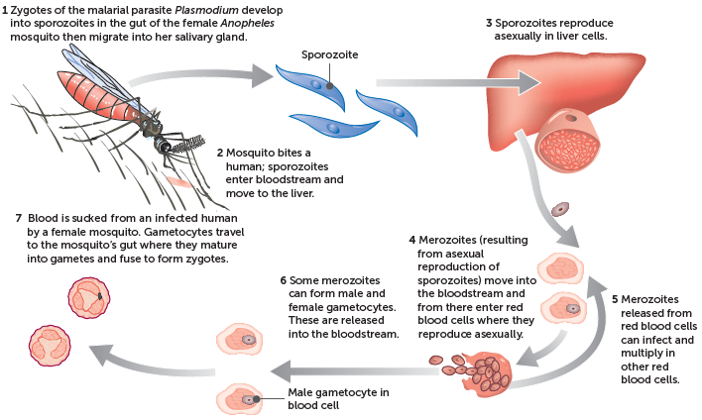
Plasmodium life cycle

Slide 32
Malaria Symptoms
Usually the incubation time for malaria is seven to 18 days.
With some species of malaria, such as Plasmodium vivax and Plasmodium ovale, the parasite can lie dormant in the liver. It can therefore take up to a year for symptoms to develop.
Once inside the body, the malaria parasites grow and multiply inside the red blood cells. When the red blood cells burst releasing merozoites (usually every 48-72 hours), it results in an attack of flu-like symptoms such as fever, sweating, shivering and shaking, muscle aches, nausea and headache. These attacks last 6-10 hours.
The type and severity of symptoms depends on which type of malaria parasite someone is infected with. For example, the most serious type of malaria is caused by the parasite Plasmodium falciparum.

Slide 33
Malaria Symptoms
All cases of Plasmodium falciparum malaria are potentially severe and life threatening.
Plasmodium falciparum primarily destroys the red blood cells which can lead to severe anaemia.
In severe Plasmodium falciparum infections, parasite-filled red blood cells may also block circulation to major organs, this can result in serious complications such as:
  Cerebral malaria (brain swells)
  Liver failure and jaundice
  Pulmonary oedema (fluid in lungs)
  Kidney failure
  Acidosis
  Enlarged spleen

Slide 34
Impact on Economy/Society
Malaria has a significant economic impact on countries with high levels of malaria transmission.
Malaria causes significant economic losses, and can decrease gross domestic product by as much as 1.3%.
In affected countries the disease accounts for:
      40% of public health drug expenditure
      30-50% of in patient hospital admissions
      Up to 60% of outpatient health clinic visits
  Malaria disproportionately affects poor people who cannot afford treatment or have limited access to health care. This traps families and communities in a vicious cycle of poverty and disease which they are unable to break away from.

Slide 35
Prevention – Controlling the spread of malaria
Vector control:
  Use of insecticide to kill mosquitoes and their larvae
  Long lasting insecticide impregnated nets.
  Indoor residual spraying
  Mosquito repellents
  Eliminate (stagnant) standing water or place covers/oil on water. This removes the mosquito breeding area and therefore disrupts mosquito breeding
  Biological control of mosquito such as mosquito fish that feed on mosquito larvae (only if safe to do so)

Slide 36
Prevention – Controlling the spread of malaria
Plasmodium control by using medications
  Preventative drug treatments.
  Anti-malaria drugs mean there will be fewer people infected with the pathogen there is no vaccine currently available in Australia, vaccines are in development)
  Host control:
  Modify Human behaviour by using physical preventative measures
    Avoid being outside at times when mosquitoes are active
    Use mosquito nets, use repellent, wear protective clothing that is light

Slide 37
3 Reasons We Still Have Not Gotten Rid of Malaria
https://www.ted.com/talks/sonia_shah_3_reasons_we_still_haven_t_gotten_rid_of_malaria

Slide 38
Factors that Make Malaria Difficult to Control
Vector
    Evolve resistance
    Breed quickly so population increases
    Can breed in small inaccessible places so can be difficult to remove breeding grounds
    Wide range which is increasing due to climate change
    Don’t show symptoms of infection

Slide 39
Factors that Make Malaria Difficult to Control
Plasmodium
    Evolve resistance to drugs
    No vaccine
    Multiple strains
    Long incubation where Plasmodium is dormant & affected individuals asymptomatic

Slide 40
Factors that Make Malaria Difficult to Control
  Host
    Common in places with
      limited healthcare
      Limited resources to buy medicine
    Hard to prevent mosquito bite

Slide 41
Watch – This is Amazing!!!
https://www.youtube.com/watch?v=TnzcwTyr6cE

Slide 42
Life Cycle – Protist Phytophthora

Slide 43
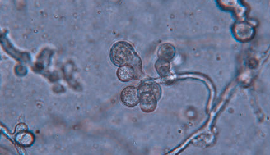
10 Phytophthora dieback (jarrah dieback)
Phytophthora (pronounced fy-TOFF-thora) dieback is a disease caused by the water mould protist Phytophthora cinnamomi.
Phytophthora is Greek for ‘plant destroyer’
Was first identified on the roots of a cinnamon tree
Elizabeth Bush, Virginia Polytechnic Institute
and State University, Bugwood.org. Licensed
under a Creative Commons Attribution 3.0
License. (https://creativecommons.org/licenses/by/3.0/)

Slide 44
10 Phytophthora dieback (jarrah dieback)
Consequences of construction developments
i.e. road works,
recreation
Invasive weeds
Grazing by feral/
introduced animals
Salinity, water table change
Small/declining
populations
Demographic
/genetic effects
Mining activities
Drought/climate change
Phytophthora dieback
Land
clearing

Slide 45
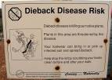

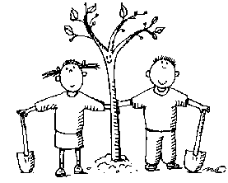

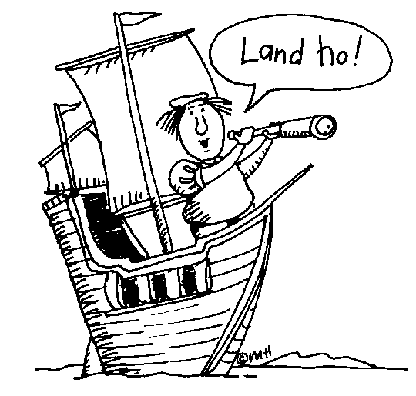
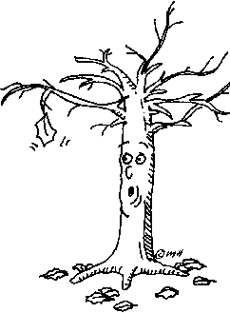
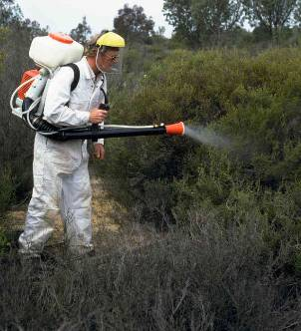
A brief history of Phytophthora dieback (jarrah dieback)
Infested gravel
used for roadmaking
Quarantine
Introduction of
European plant species
1829
1920
1948
1964
1989
1973
1996
Research station est. Dwellingup
Pc identified
as causal agent
Early European
settlers arrive
First recorded unexplained
tree deaths (Karragullen)
Use of phosphite

Slide 46
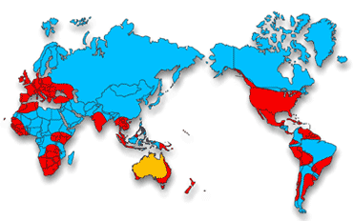
Distribution of Phytophthora cinnamomi

Slide 47
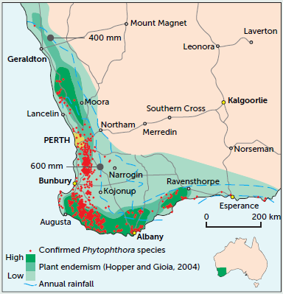
Map of Phytophthora distribution in WA

Slide 48
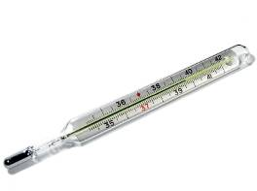


Ideal environment
>800mm
20ºC-30ºC
pH 5-6
Therefore:
  Forested areas with higher rainfall
  Grows and spreads best in autumn and spring

Slide 49
Phytophthora dieback (jarrah dieback)
Phytophthora cinnamomi belongs to a group of micro-organisms called water moulds in the phylum Oomycota
They were once in the Fungi Kingdom
They have since been removed from this kingdom & placed in the Kingdom, Protista

Slide 50
Phytophthora structural characteristics
Belong to a group of Protista resembling plants
Have a cellulose-based cell wall
Have 2 flagella, one hairy & one smooth for locomotion
Also have an extensive network of filaments to allow for nutrient uptake

Slide 51
Mode of Transmission
Soilborne
Spores spread through the soil
Spore also spread by:
      Human activity
      Movement of contaminated soil
      Plants
      Equipment
      Animals
  Spores carried by water runoff
  Direct contact – spread by root to root contact

Slide 52
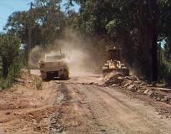
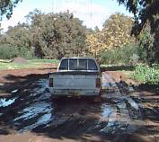
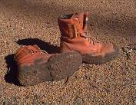
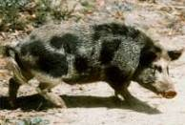

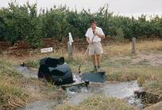
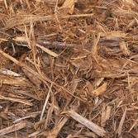
Mode of Transmission
4WD
Road making
Hiking boots
Animals
Trail/mountain bikes
Irrigation
Infected plant material

Slide 53
Impact on Host
It is a plant pathogen that affects plants in Australia such as jarrah, banksia and grass trees, by attacking and feeding off their root systems.
In WA, more than 40 per cent of native plants are susceptible to the disease, particularly in the state’s south-west.
Areas currently experiencing spread are along the coast in Two People’s Bay Nature Reserve and in metropolitan Perth bushland areas such as Lightning Swamp Bushland.
After infecting a plant, it grows rapidly in the roots.
Causes root rot which stops plant taking up nutrients and water
Ultimately leads to death of the plant

Slide 54
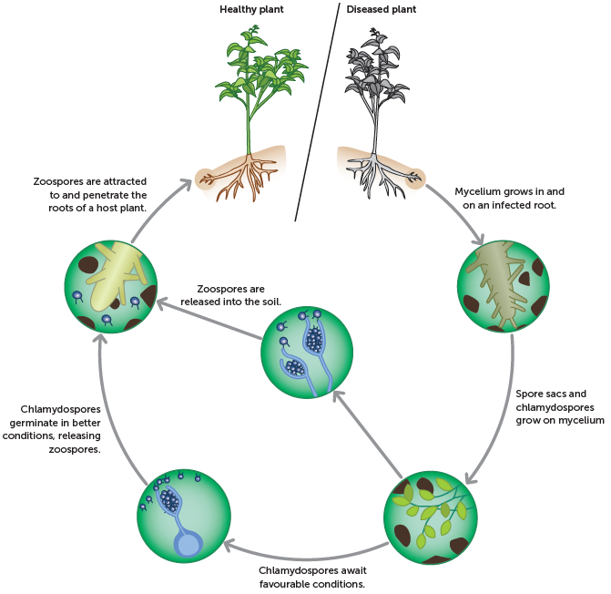
Phytophthora life cycle

Slide 55
1. Zoospores are released in very large numbers under moist soil conditions.
They have flagella (tails), which are used to propel the spore through the soil water towards other plant roots.
The movement of water down slope, through or over the soil, can also passively disperse these spores over considerable distances.
Zoospores are attracted by the root secretions of some plants.
They then penetrate the root, germinate and the cycle repeats itself.
Notes:
55

Slide 56
2. Chlamydospores are larger, long-lived spores with thick protective walls.
These spores can withstand dry conditions for months, germinating when warm moist soil conditions re-occur.
This is one of the mechanisms the protozoan has developed to help it survive adverse conditions.
These spores may survive being transported long distances in dry soil

Slide 57
Impact on Society & Environment

Slide 58
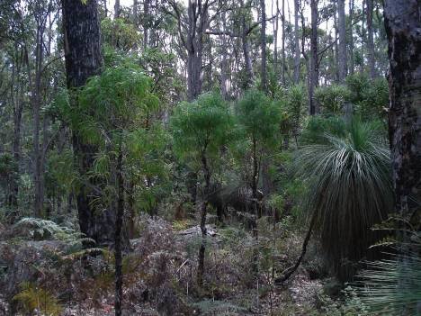
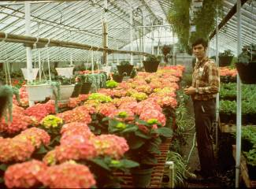
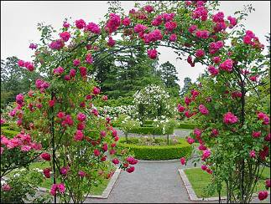
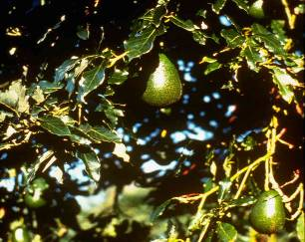
Where is dieback found?
bushland
gardens
nurseries
horticultural
plantations

Slide 59
Impact on native flora
Of 5710 recorded species of plant:
  2300 (40%) susceptible to Phytophthora dieback
  800 (14%) highly susceptible to Phytophthora dieback

Slide 60
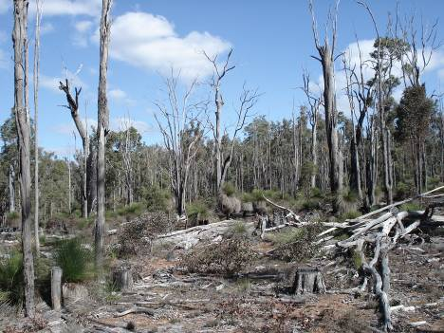
Jarrah forest –
Dwellingup

Slide 61
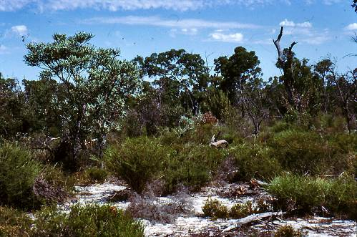
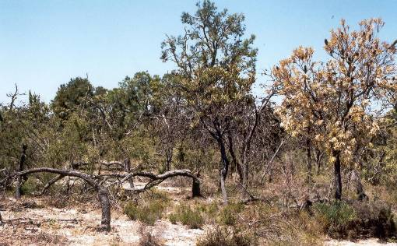
Banksia woodland

Slide 62
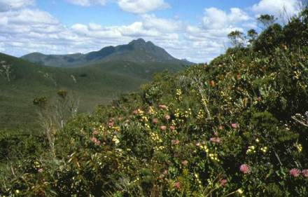
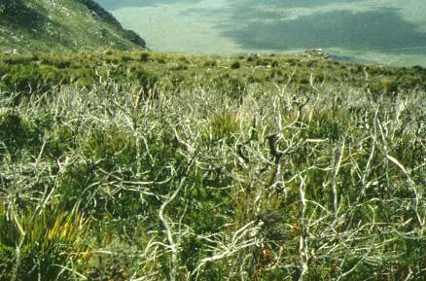
Stirling Range
National Park
Notes:
Biomass Reduction

Slide 63
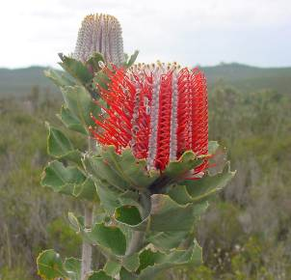
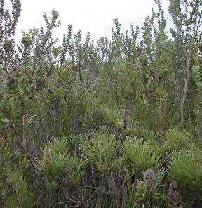
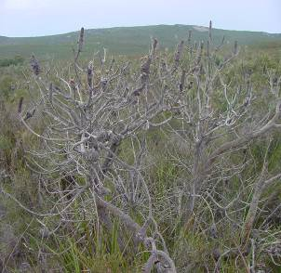
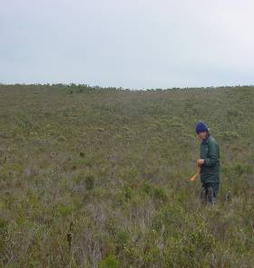
South Coast
Notes:
Biomass Reduction

Slide 64
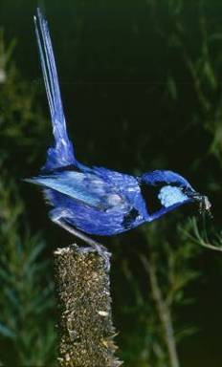
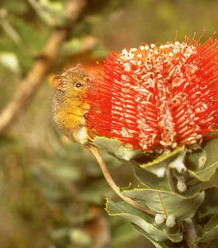
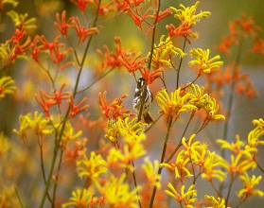
Impact on animals?
Loss of:
  food
  habitat
  shelter
Notes:
64

Slide 65
Control of Phytophthora Dieback

Slide 66
Controlling Phytophthora Dieback
There is no known cure for Phytophthora dieback therefore prevention is the key to managing dieback.
Prevention is cheaper & more effective than managing the impacts of the disease once introduced to a bushland

Slide 67
Management of Phytophthora dieback
Interpretation and mapping
    Is Phytophthora dieback known or likely to be in an area, or at your site? Do you need more information?
Identify priority areas, species or communities for protection
    Declared rare flora
    Endangered fauna
    Is the area protectable
Prevent accidental introduction, Minimise spread, Reduce impact
          Through Quarantine & Hygiene

Slide 68
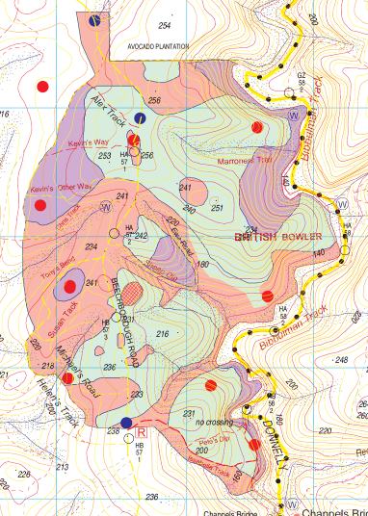
Dieback Interpretation & Mapping
Dead “indicator plants”
  Structural change
  Chronology of deaths
Soil/tissue sampling

Slide 69
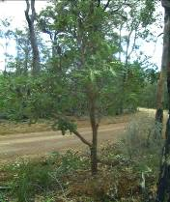
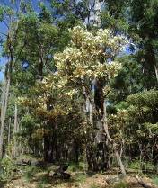
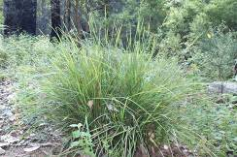
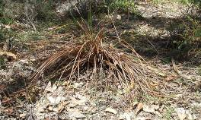
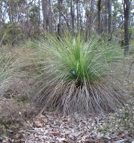
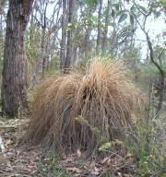

Indicator species
Banksia grandis (Bull Banksia)
Patersonia spp. (Flag Flower)
Xanthorrhoea preissii (Balga)
Notes:
69

Slide 70
Identify protectable areas
Focus resources on areas of highest biodiversity value
    Declared rare fauna
    Endangered fauna
    Threatened ecological communities
Focus resources on areas which can be protected
    Uphill from known infections
    Large enough to protect (>2ha)
    Able to be effectively quarantined (limited public access, sources of infection can be mitigated or removed)
Focus resources on areas where the benefits of hygiene will last more than a few decades

Slide 71

Prevent accidental introduction – Quarantine & Hygiene
Readily introduced in infested material (e.g. soil on footwear or vehicles, infected plant material, gravel for road construction, nursery stock)
Impossible to eradicate
Prevent introduction by
  Use of certified dieback free materials
  Quarantine – Remove and control access
  Hygiene – footbaths and vehicle washdown

Slide 72




Quarantine
Notes:
72

Slide 73



Hygiene
Footwear & equipment
Vehicles

Slide 74


Education

Slide 75




Minimise spread
Reduce water flow
Barriers to infection

Slide 76


Phosphite – preventative treatment
Highly effective – gives short term resistance to some plants (allowing them to resist infection)
Low toxicity
Environmentally friendly
Can be sprayed or injected

Slide 77



Reduce impact - conservation
Seedbank
Revegetation
Translocation

Slide 78
Read & Complete activities
This resource is fantastic & has many links to how Phytopthora dieback is currently managed in WA: https://www.dpaw.wa.gov.au/management/pests-diseases/phytophthora-dieback
Set 13.3 pg.450 Q 1-5
Biozone Act – 81 & 82
Watch the Video on Managing Dieback in WA: https://www.youtube.com/watch?v=StP-KEGg6-0

